Slide 1
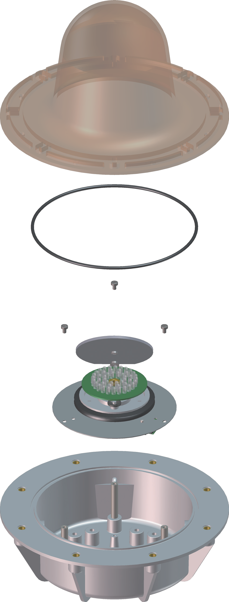
Luz Giratoria Espejo LED RFG/RMLED
1
3
1
RFG/DC/12-55/ RFG/UC/115-230/
RMLED RMLED
-ve (0V) N
+ve (10-55Vdc) E P
(115-230V ac/dc)
2
4
_{MB7}
_{MB10}
G7
SOVERIN CONTROL, S.L. Alameda Urquijo, 80 dpto. 7 - 48013 – BILBAO (Vizcaya)
Tfno: +34 94 454 33 33 Fax: +34 94 454 50 77 E-mail: info@soverincontrol.com Pag web: www.soverincontrol.com

