Slide 1
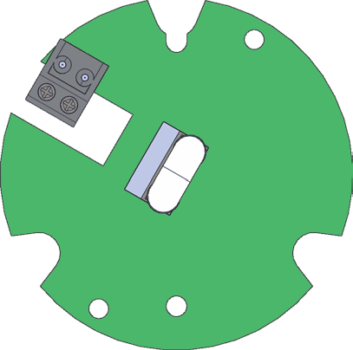
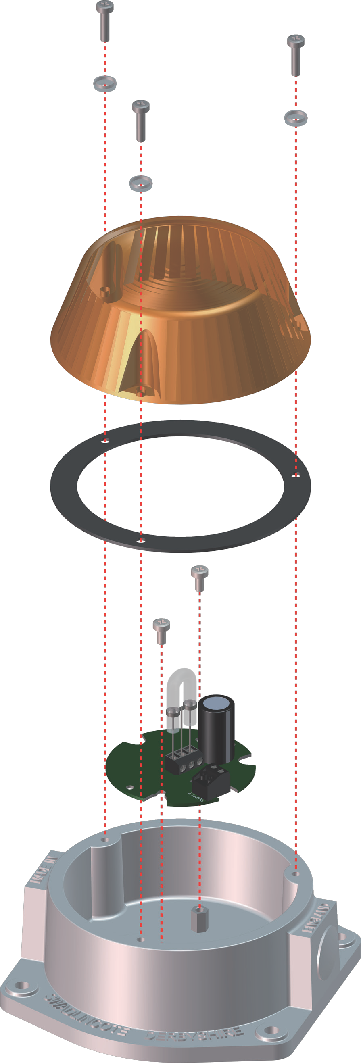
Luz Intermitente de Xenon XFS/SH/2.5J
1
3
1
XFS/DC/12-24/ XFS/AC/115/ XFS/AC/230/
-ve (0V) N N
+ve (10-27Vdc) P (115Vac) P (230Vac)
2
4
_{MB7}
G3
SOVERIN CONTROL, S.L. Alameda Urquijo, 80 oficinas - 48013 – BILBAO (Vizcaya)
Tfno: +34 94 454 33 33 Fax: +34 94 454 50 77 E-mail: info@soverincontrol.com Pag web: www.soverincontrol.com

