Slide 1
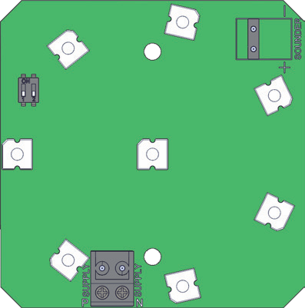
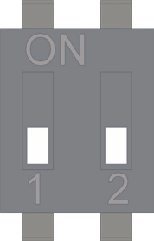
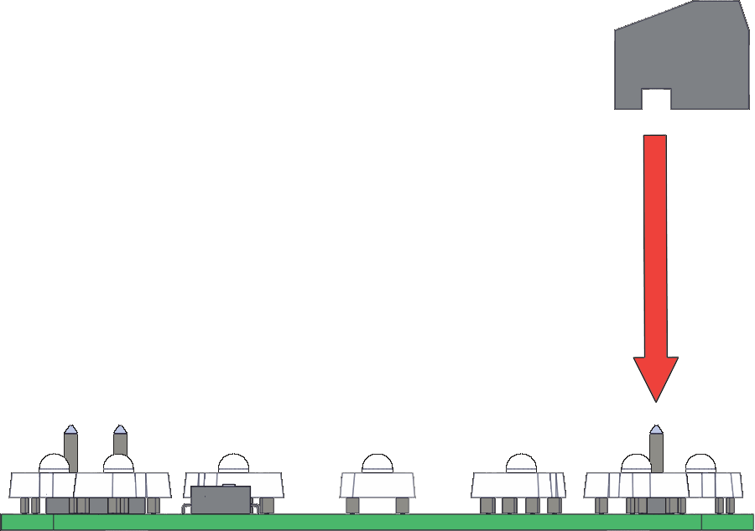
Luz Fija / Intermitente PSS/LED
1
2
4
1
2
PSR/DC/12-55/ PSR/AC/24/ PSR/UC/115-230/
-ve (0V) N N
+ve (10-55Vdc) P (24Vac) P (98-264Vac/dc)
3
_{MB7}
G3
SOVERIN CONTROL, S.L. Alameda Urquijo, 80 dpto. 7 - 48013 – BILBAO (Vizcaya)
Tfno: +34 94 454 33 33 Fax: +34 94 454 50 77 E-mail: info@soverincontrol.com Pag web: www.soverincontrol.com

