Slide 1
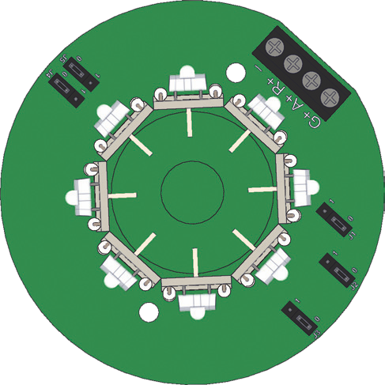
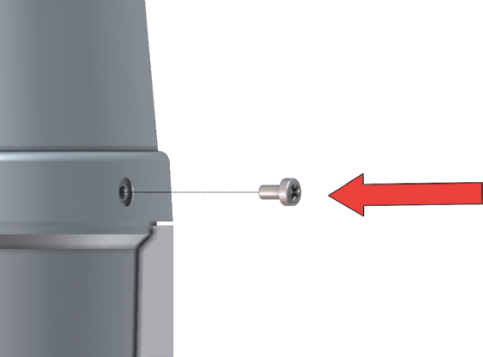
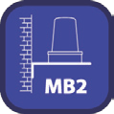
Luz Tricolor PSB/HP-LED/RAG
1
2
4
3
1
2
3
_{Colour} PSB/DC/24/ PSB/UC/115-230/
-ve (0V) N _{Red} +ve P
Amber +ve P
Green +ve P
HP-LED/RAG
HP-LED/RAG
(24Vdc)
(98-264Vac/dc)
(24Vdc)
(98-264Vac/dc)
5
(24Vdc)
(98-264Vac/dc)
_{MB1}
SOVERIN CONTROL, S.L. Alameda Urquijo, 80 dpto. 7 - 48013 – BILBAO (Vizcaya)
Tfno: +34 94 454 33 33 Fax: +34 94 454 50 77 E-mail: info@soverincontrol.com Pag web: www.soverincontrol.com

