Slide 1
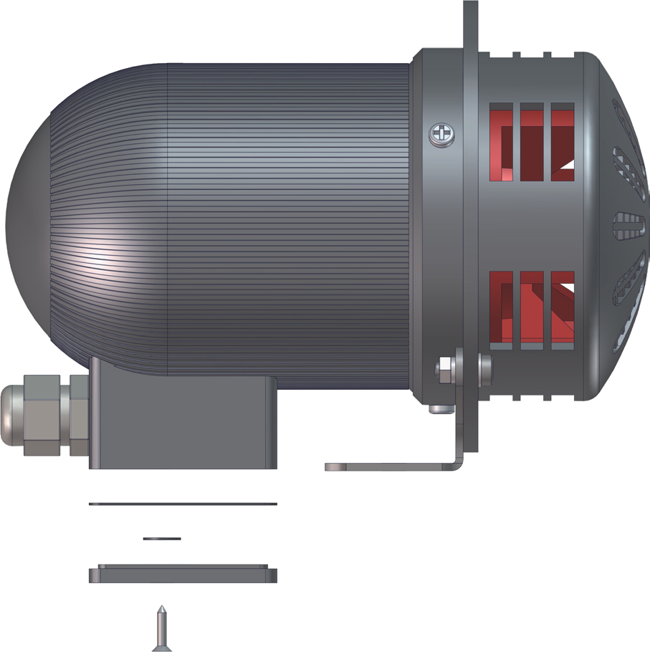
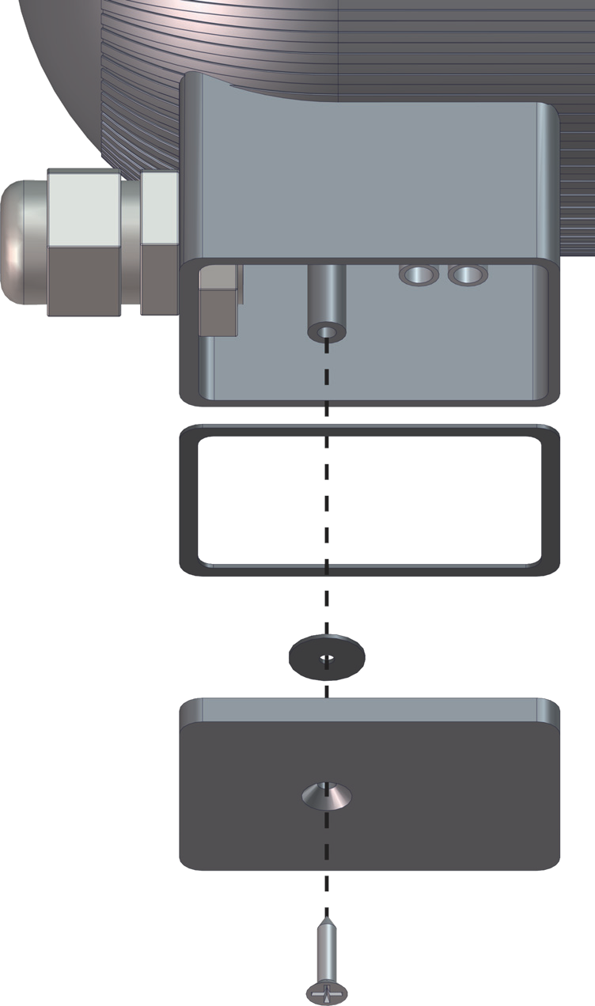
Motor – Driven siren MDS-1
2
Whilst a cable gland is supplied, it is the installer’s responsibility that it is both fitted correctly and suitable for the supply cable in use.
1
UC/12 UC/24 UC/115/ UC/230/
-ve -ve
Earth Earth
+ve +ve P P
MDS-1/
MDS-1/
MDS-1/
MDS-1/
(0V)
(0V)
N
N
(12Vuc)
(24Vuc)
(115Vuc)
(230Vuc)
Note:
This unit is rated for a duty-cycle of 5 minutes on - 10 minutes off.
The unit should ideally be mounted in a horizontal position. In environments where dirt or particles may fall onto the moving parts of the siren’s impeller, it is recommended to mount the unit with the nose cone facing down.
For fitment of unit, mount in desired position using both mounting holes situated on the mounting foot.
Replace teminal cover prior to applying power to the unit.
SOVERIN CONTROL, S.L. Alameda Urquijo, 80 dpto. 7 - 48013 – BILBAO (Vizcaya)
Tfno: +34 94 454 33 33 Fax: +34 94 454 50 77 E-mail: info@soverincontrol.com Pag web: www.soverincontrol.com

